Slide 1
Design Patterns CHALLENGE
Endava bank, 2018

Slide 2
agenda
Description
CRDU Functionality
ANSWERS
Q&A

Slide 3

description
How do we work as a team?
How do we develop the challenge?
Data Base structure
Logic functionality
Manual testing

Slide 4
CRDU FUNCTIONALITY

Slide 5
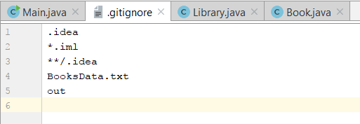
answers
What tool or command did you use to ignore the .idea files?
The .gitignore file

Slide 6
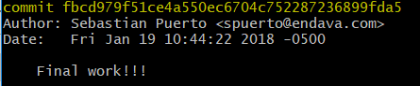
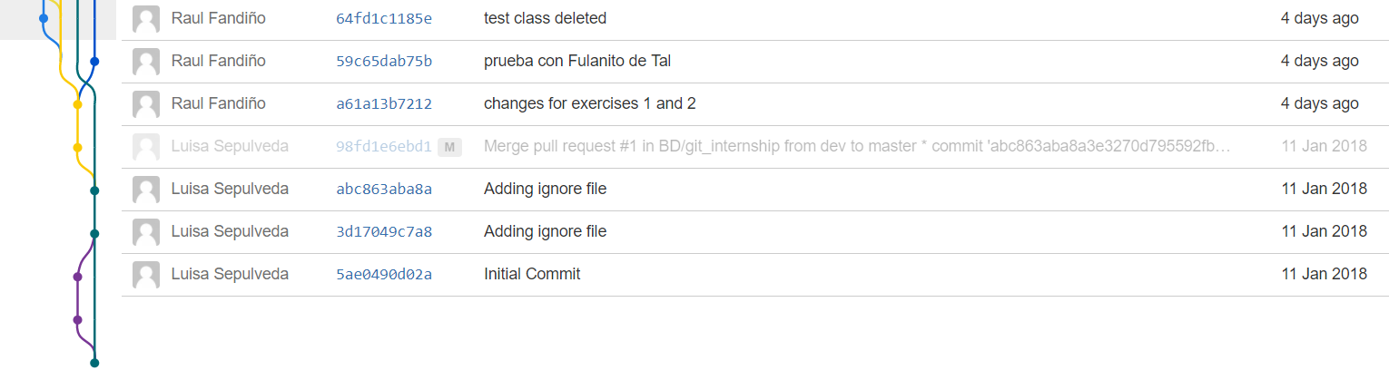
answers
Could you described the second commit done in the repository in order to know:
Commit ID, Author, Date and Message
The Git log command

Slide 7
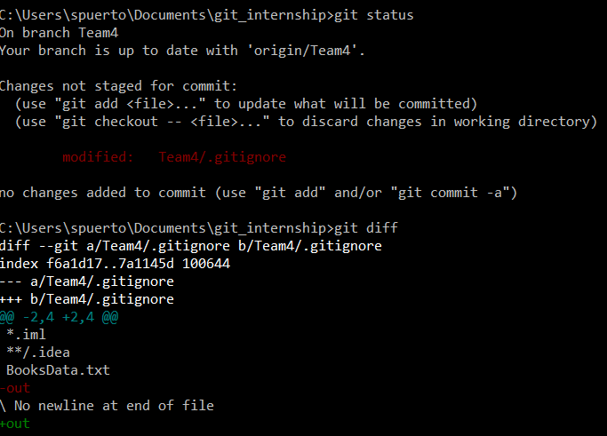
answers
How do you be able to know the changes done to a file?
The git status command

Slide 8
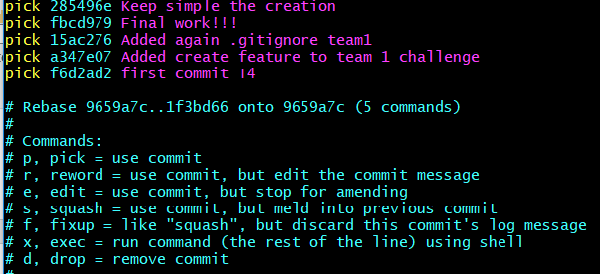
answers
Have you used merge or rebase? Why have you chosen it?
Rebase –i HEAD ~ #

Slide 9
answers
What commands did you use thorough all the challenge? Why did you use them?
Git add .
Git commit –am “comment”
Git pull
Git push
Git diff
Git branch
Git status

Slide 10

Q&a

Slide 11
Eduardo galeano
Application management
Luis Zarate
Testing
Sebastian puerto
devops

